Slide 1


Text Classification Twitter Sarcasm Detection
Group Name – Sarcasm Experts
GitHub Link - https://github.com/dheerajpatta/CourseProject
Artsiom Strok astrok2@illinois.edu
Peter Zukerman
peterz2@illinois.edu
Dheeraj Patta (Captain)
npatta2@Illinois.edu
CS410 Text Information Systems - Competition

Slide 2

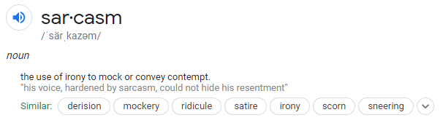
The Problem Statement
Classify a given sequence of tweets (responses) as sarcastic or not sarcastic.
The objective of this competition is to predict the “label” of the response (tweets) using the given context (either immediate or full context)
The tweets are provided with conversation context which is an ordered list of dialogue. The responses are the tweets to be classified.

Slide 3
Why Sarcasm is a hard NLP problem
Sarcasm is one of the most complex forms of figurative human expression—and therefore it’s one of the hardest to teach AI systems.
Narrow field of research in Natural Language Processing (NLP).
Specific case of sentiment analysis where focus is on sarcasm/mockery instead of polarity or sentiment in the whole spectrum.
Common challenges of Sentiment Analysis include Negations, Ambiguity, Multi-polarity and Sarcasm.
Beyond Ambiguity, to be able to interpret tone and meaning of a statement in the context of other statements is hard.
Hard for machines to understand the contradiction between literal and intended meaning.
Knowledge about the external world, environment and context is often needed to understand sarcastic comments.

Slide 4
Our Approach
Problem Statement
Understanding Data
Exploratory Data Analysis (EDA)
Data Pre-processing
Data Augmentation and Enrichment
The given twitter dataset is thoroughly examined and analyzed to understand the context and relationships like distribution, summary stats and attributes.
Classic Algorithms Modeling
Deep Learning Models
State-of-the Art Models
The processed data is utilized to train classic models at first and then deep learning models. The winning model is SOTA BERT model.
Feedback loop
Every model is evaluated using traditional metrics like Accuracy, F1, AUC, ROC curves etc. The models are hyper-parameter tuned to perform to optimum as well as large pre-trained weights are used for BERT model.
Evaluation and Metrics
Pre-trained Weights
Hyper-parameter Tuning
Iterate and improve until best results with state-of-the-art results/leaderboard rankings
Final Winning Classifier

Slide 5
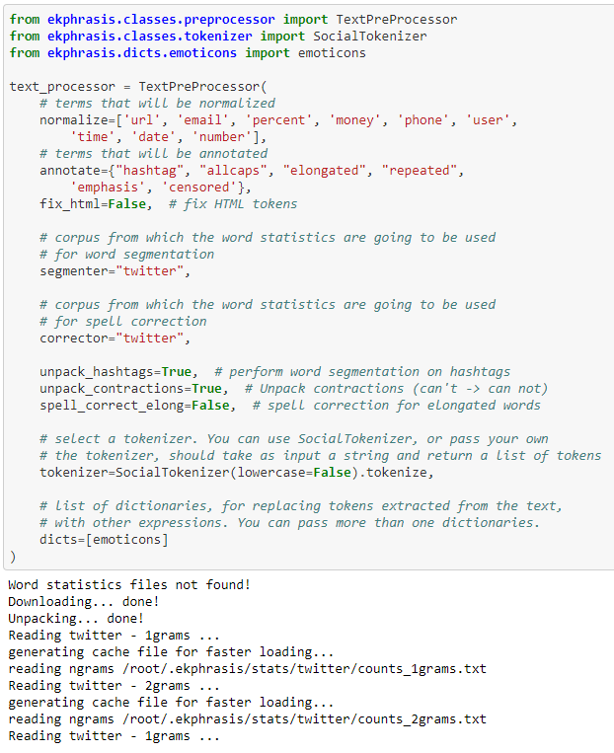
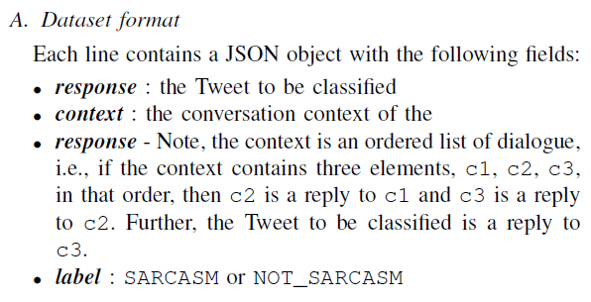
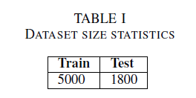
Understanding Data and Pre-processing
Basic Attributes
Pre-processing
We’ve performed the following data pre-processing steps using genism,
POS tagging,
Tokenization
Lemmatization
Label Encodings
Word Embeddings etc.
and utilized ekphrasis package to perform specialized tasks like
Social Tokenization
Text pre-processor
Word Segmentation on Hashtags
Unpack Contractions (can’t to can not),
Spell Correction and
Emoticon Analysis
* Code snippet from final BERT model

Slide 6
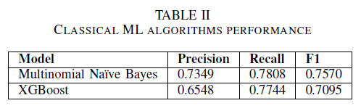
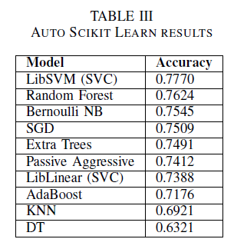
Initial Modeling (Classic)
Below is the list of classic models developed using Python’s
scikit-learn and their performance metrics.
Classic Algorithms developed –
Count Vectorizer
TD-IDF Transformer
Multinomial Naïve Bayes
Stochastic Gradient Descent (SGD)
Boosting Algorithms developed –
Gradient Boosting (GB)
XG Boosting (XGB)
Validation Mechanism -
K-fold stratified cross validation
Source Code
https://github.com/dheerajpatta/CourseProject/blob/main/models/sarcasm_classification.ipynb

Slide 7
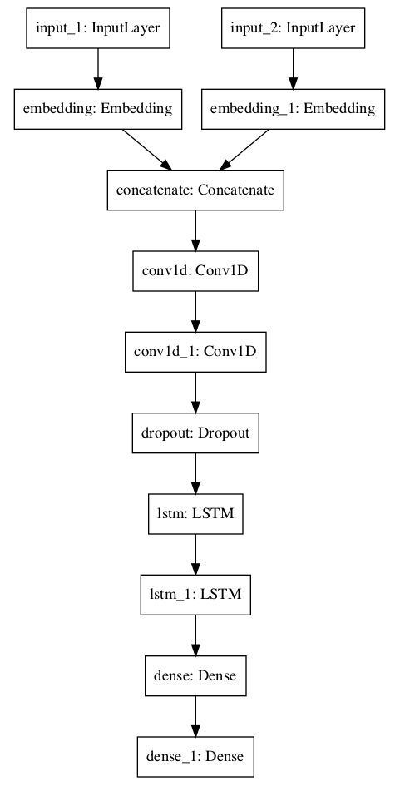
Modeling (Deep Learning Models)
We’ve developed deep learning model developed using TensorFlow and high-level abstraction framework Keras.
NLP steps -
Word Embeddings - Word2Vec, Glove (Genism)
Keyed Vectors (Genism)
Label Encodings
Deep Learning Models -
Conv 1D (CNN)
Long Short Term Memory (LSTM)
Dropouts
Dense/Hidden Layers
Evaluation Metric -
Categorical Cross-entropy
Source Code
https://github.com/dheerajpatta/CourseProject/blob/main/models/sarcasm_classification_deep_learning.ipynb

Slide 8
State-of-the-art (SOTA) Modeling - BERT
What is BERT?
BERT stands for Bi-directional Encoder Representations from Transformers. BERT is a general purpose pre-trained model that can be
finetuned on smaller task-specific datasets like sentiment analysis, question & answer system etc.
Why BERT?
BERT was revolutionary when introduced by Google. It is bidirectionally trained which means it has deeper sense of language context and flow compared to Uni-directional models.
Instead of predicting the next word in a sequence, BERT makes use of a novel technique called Masked LM (MLM): it randomly masks words in the sentence and then it tries to predict them and uses the full context of the sentence, both left and right surroundings, in order to predict the masked word. Unlike the previous language models, it takes both the previous and next tokens into account at the same time.
How BERT works?
BERT relies on Transformers (the attention mechanism that learns contextual relationships between words in a given text)
A basic Transformer consists of an encoder to read the text input and a decoder to produce a prediction for the task. The input to the encoder for BERT is a sequence of tokens, which are first converted into vectors and then processed in the neural network.
https://github.com/google-research/bert

Slide 9
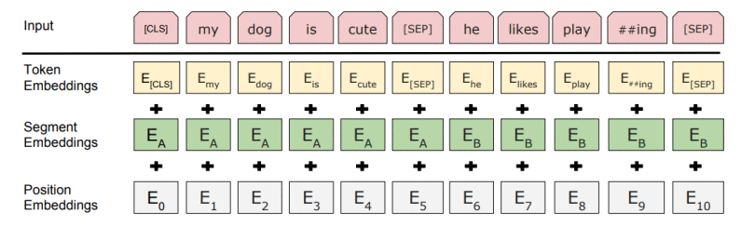
BERT (continued)
Transformer Architecture
Encoder
Feed Forward
Feed Forward
Input
Encoder – Decoder Attention
Output
Sequence of Tokens/Vectors
Self-Attention
Self-Attention
Sequence of Vectors with 1:1 correspondence
to Inputs
BERT needs the input to be massaged and decorated with some extra metadata:
Token embeddings: A [CLS] token is added to the input word tokens at the beginning of the first sentence and a [SEP] token is inserted at the end of each sentence.
Segment embeddings: A marker indicating Sentence A or Sentence B is added to each token. This allows the encoder to distinguish between sentences.
Positional embeddings: A positional embedding is added to each token to indicate its position in the sentence.
Input Embeddings = Token + Segment + Position Embeddings

Slide 10
Our State-of-the-art (SOTA) Modeling (BERT Base)
We’ve developed our BERT model using TensorFlow and high-level abstraction framework Keras. Google Colab is used to develop, train, deploy and evaluate BERT model.
BERT Model Architecture
Google’s Pre-trained BERT-Base Model
BERT-Base, Uncased
12-layers, 768-hidden-nodes, 12-attention-heads
Trained Parameters - 110M parameters
Stock Weights / Pretrained Weights.
Trained using Google Cloud NVDIA GPUs (Google Colab)
BERT Model Evaluation Metrics
Confusion Matrix
Classification Report
Accuracy, Precision, Recall, F1 score

Slide 11
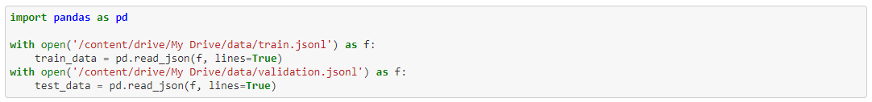
Our BERT Model Implementation Explained
Mounting drive for saving all activity
Pandas for reading and writing to files. Read the given JSON train file
Data prep/cleanup – Remove non-contextual/meaningless redundant words like @USER, <URL>
Data pre-processing for specialized NLP tasks like Social Tokenizer, Emotion Understanding etc.

Slide 12
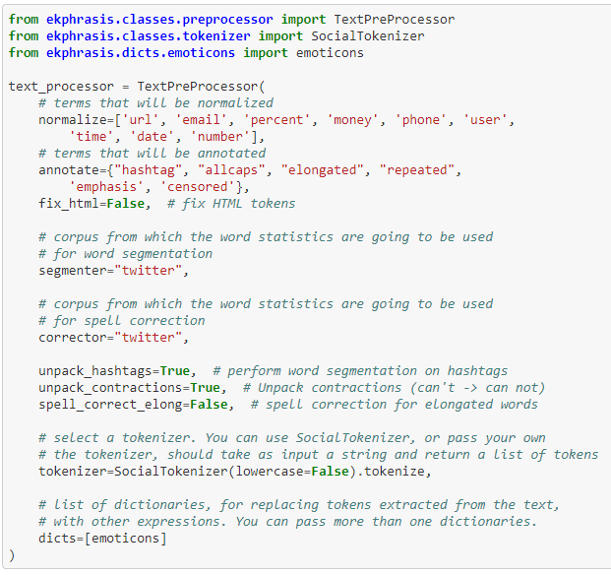
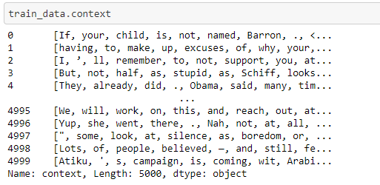
Our BERT Model Implementation Explained
Using ekphrasis to pre-process and enrich data
Rich data ready for Training
Using ekphrasis text-processor methods for response and context

Slide 13
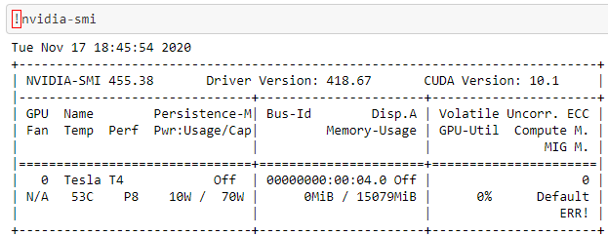
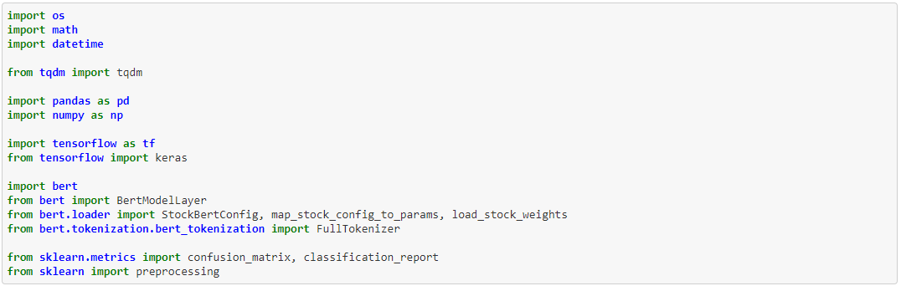
Our BERT Model Implementation Explained
Utilizing GPUs for training
Install all necessary libraries and frameworks

Slide 14
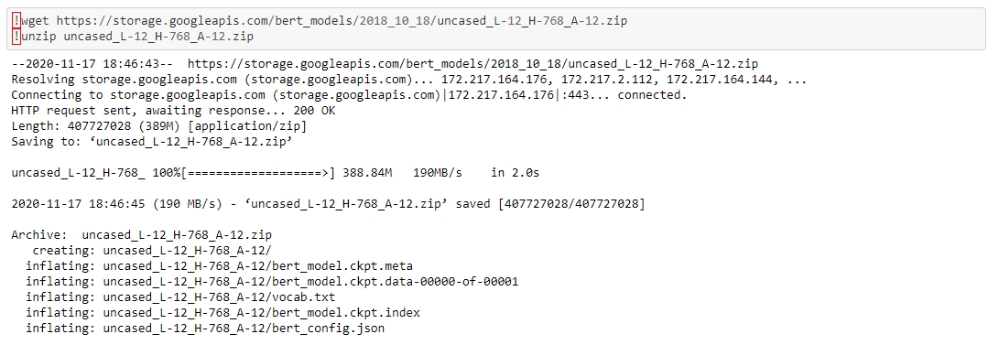
Our BERT Model Implementation Explained
Download pre-trained BERT-Base model weights

Slide 15
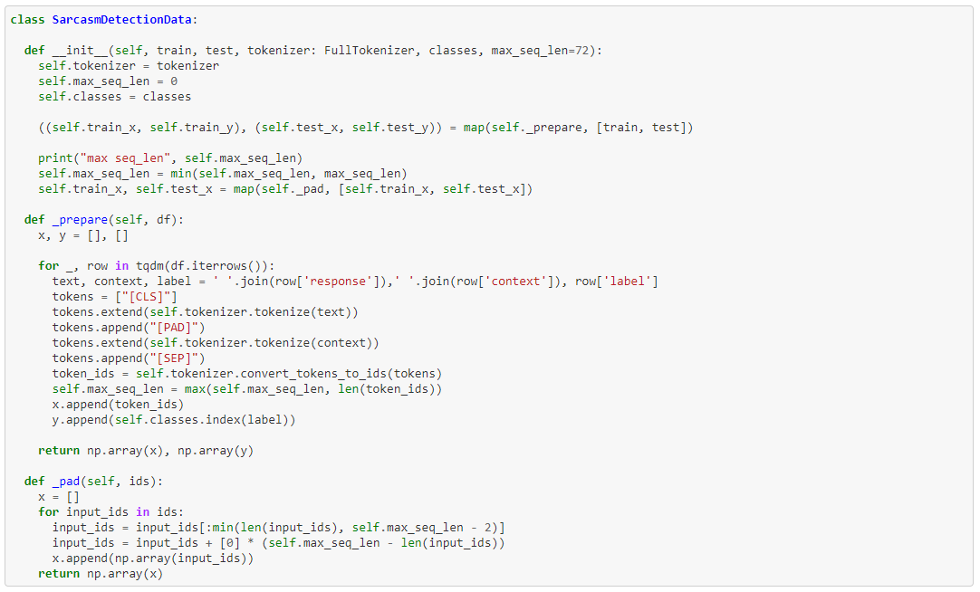
Our BERT Model Implementation Explained
Preparing the data as required by BERT (CLS, PAD, SEP)
Initiating the Tokenizer as well as sequence length and classes.
The prepare() is used to create the input sequence of tokens/vectors in the way required by BERT.
Input Embeddings = Token + Segment + Position Embeddings
(CLS, PAD, SEP)
Utilize the Full Tokenizer provided by BERT

Slide 16
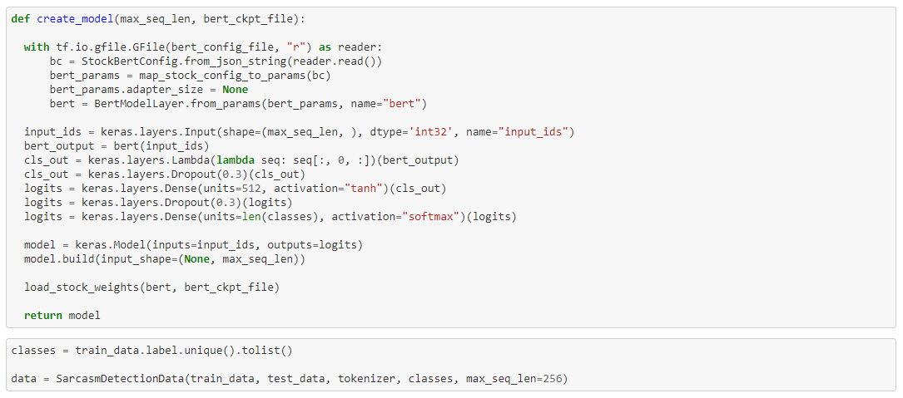
Our BERT Model Implementation Explained
Create BERT Model using input sequences and stock BERT config files. Create Deep NN with dropouts, hidden/dense layers.
We make use of activation functions of tanh and softmax for dense layers.

Slide 17
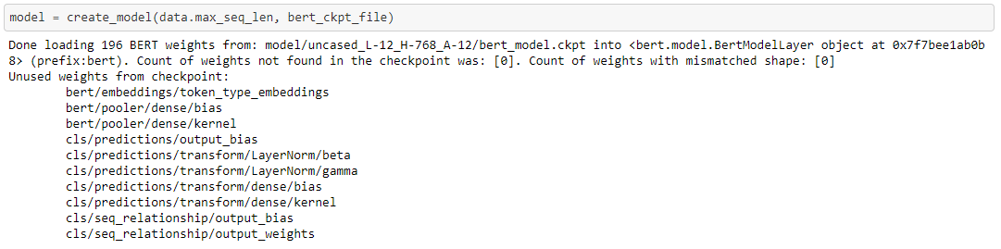
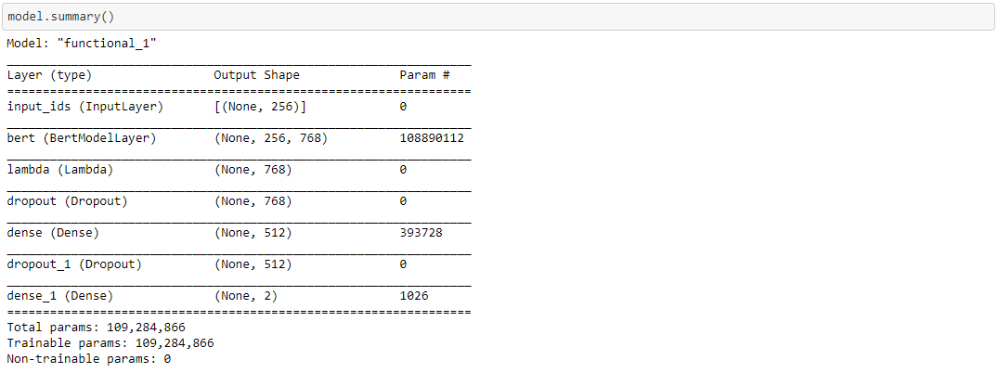
Our BERT Model Implementation Explained
Create Model using BERT Weights from downloaded pre-trained model
This shows the summary of BERT Model with all the layers.
As shown here, the Model contains Input layer, BERT layer, lambda function, dropouts and dense/hidden layers.
Total parameters and trainable parameters are also shown here.

Slide 18
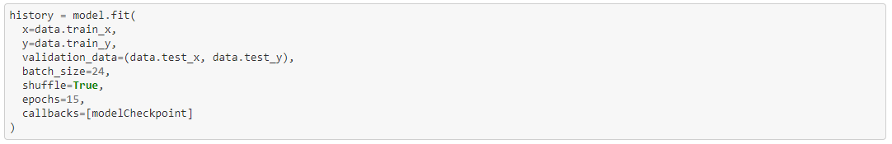
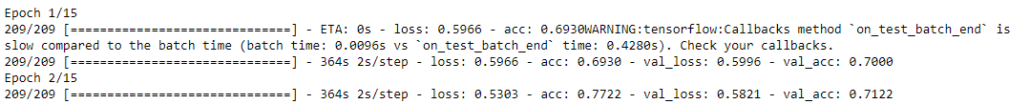
Our BERT Model Implementation Explained
Compiling the Model with “Accuracy” as Evaluation Metrics.
Saving the checkpoints to TensorFlow recommended hdf5 format for later use (we can load these checkpoints instead of re-training)
Fitting/Training the BERT Model with a batch size of 24 and epochs of 15 and callbacks/checkpoints to save progress.
…

Slide 19
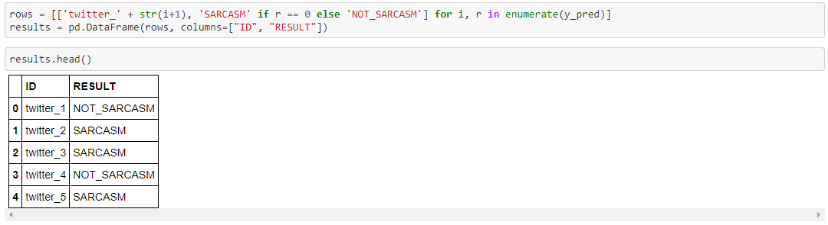
Our BERT Model Implementation Explained
Load our Training Weights specific to task of classifying Tweets whether Sarcastic or not.
All that is left is to now “predict” the labels of test/validation dataset using the above loaded weights
Create a data frame of ID, Result from the Prediction
Write the results to answer.txt

Slide 20
System Requirements (Installation)
1. All our models are in .ipynb format and can be easily replicated by using Jupyter / Google Colab or any other notebook environment.
2. We recommend anaconda distribution to create virtual environments for Python and recommend Google Colab for TensorFlow (TF)/Keras
Implementations.
3. If you want to use BERT with Colab, you can get started with the notebook "BERT FineTuning with Cloud TPUs".
4. To replicate our BERT model, we highly recommend downloading and using pre-trained stock weights. https://storage.googleapis.com/bert_models/2018_10_18/uncased_L-12_H-768_A-12.zip
5. We’ve limited our training to 15 epochs only and the model can be trained for more epochs or perform hyper-parameter tuning to achieve even better results.
6. All about setting up Google Colab https://medium.com/@robertbracco1/configuring-google-colab-like-a-pro-d61c253f7573
7. You need to install the following to execute our BERT code -
Python 3 or above
Google Colab / Google Drive (for Mounting)
Ekphrasis (for pre-processing of data)
tensorflow-gpu
tqdm
bert-for-tf2

Slide 21
Project Team Contributions
As a team, we had very clear goals from the initiation of this project/competition. Below are key highlights and contributions of team members -
Task | Team Member | Highlights
Understanding and Documenting the Problem statement | Dheeraj Patta | Clear and concise documentation with clear goal setting.
Research Data Pre-processing mechanisms and linguistics | Peter Zukerman | New package ekphrasis was introduced and utilized in our models.
Research current SOTA Models and GLUE Metrics + Papers | Dheeraj Patta + Artsiom Strok | We’ve researched several cutting edge papers related to sentiment and sarcasm analysis.
Implementation of Classic Models and Evaluation Metrics | Artsiom Strok | Quick implementation of classic models led us to understand the depth of the problem which required sophisticated language models than simpler models.
Exploratory Data Analysis (EDA) and Context Understanding | Dheeraj Patta | Visual and Exploration of given twitter dataset.
Implementation of Boosting Algorithms and Evaluation | Dheeraj Patta | XGBoost, CATBoost and Gradient Boosting on top of Classic Algorithms.
Data Augmentation and Enrichment of Data | Peter Zukerman | Social Tokenizers, Hashtag Word Embeddings, Emoticon understanding, unpacking contractions, spell corrections etc.
Implementing a Deep Learning CNN+LSTM Model | Artsiom Strok | DL Model to include a CNN+LSTM with Dropouts and Dense/hidden layers. Failed to perform due to lack of data.
Project Proposal and Progress Report | Dheeraj Patta + Artsiom Strok + Peter Zukerman | Full scores from Reviewers.
Implementation of BERT Model | Artsiom Strok + Peter Zukerman | Our Winning Model – Using pretrained BERT Model. This is our implementation of classic BERT model.
Evaluation, Training and Metrics | Artsiom Strok + Dheeraj Patta | All evaluation tests were performed, documented and recorded for finetuning of all our models.
Implementing Hugging Face Transformers* | Dheeraj Patta | In Progress. Would like to explore the Transformers and see if there is any improvement in our winning model.
Presentation and Final Submission | Dheeraj Patta + Peter Zukerman | Final Submission of documentation with comprehensive walk-through of Project.

Slide 22
Leaderboard Rankings
Model | Precision | Recall | F1 | Beat the Baseline | Rank
Classic | 0.681 | 0.684 | 0.683 | No | 34
BERT | 0.691 | 0.845 | 0.761 | Yes | 2
BERT Sentiment | 0.692 | 0.845 | 0.761 | Yes | 5
BERT | 0.692 | 0.845 | 0.761 | Yes | 10

Slide 23
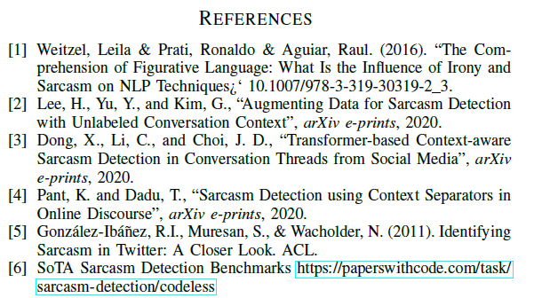
References
https://super.gluebenchmark.com/leaderboard/
https://arxiv.org/pdf/2006.06259v1.pdf
https://arxiv.org/pdf/2005.11424.pdf
https://arxiv.org/pdf/2006.00850.pdf
https://www.aclweb.org/anthology/P11-2102.pdf
https://paperswithcode.com/task/sarcasm-detection/codeless

